Slide 1
Personality Type & Spirituality
Presented by:
Ron Sturgis, Ph.D.

Slide 2
Individuality is born in the eccentricities and unexpected shadow tendencies of the soul, more so than in normality and conformity. One who cares for the soul becomes someone at ease with idiosyncrasies and the unexpected.
Thomas Moore (Care of the Soul)

Slide 3
MBTI History
Developed by Isabel Briggs Myers and her mother, Katharine Briggs
Based on Jung’s (1923) theory of psychological types
Differences in behavior are not random
due to consistent differences in perception & judgment

Slide 4
Preference-NOT Skill
Write your name on a piece of paper.
Now write it again with your other hand.
MBTI is about preferences, not about concrete, specific types of personality.
People have preferences for the various types, but they have ability in all the types.

Slide 5
Remember…
The MBTI does not measure skill, ability, intelligence or psychopathology!!!!!
You self-validate your type, nobody else can validate your type.
Using your non-preferred type is difficult, not impossible.
Developing non-preferred characteristics may be a path to spiritual growth.

Slide 6
Type Guidelines
No type is better than another, just different
Everyone uses all type preferences at times
One preference is favored on each scale
Scores indicate clarity/consistency of choice, not strength
Psychological type can explain some human behavior—not all
Type should never be used as an excuse for behavior
Notes:
No one type is better than another, just different
Everyone uses all type preferences at times
One preference is favored on each scale
Scores indicate clarity/consistency of choice, not strength or skill in using the preference
Psychological type can explain some human behavior—not all
Type should never be used as an excuse for behavior

Slide 7
Type Preferences
Notes:
The LENS trough which we see the world

Slide 8
Preference Dichotomies
Extraversion ENERGY Introversion
Sensing INFORMATION INtuition
Thinking DECISIONS Feeling
Judging LIFESTYLE Perceiving
Notes:
E-I: How we would look the most different from each other
Where and how we “charge our battery” & express the other aspects of personality type

Slide 9
Extroversion-Introversion
From where do you get your energy?
Where do you prefer to focus your attention?
What’s Energizing

Slide 10
Extroversion
Attention flows out to objects and people in the environment,
desires to act on the environment, affirm its importance;
awareness and reliance on environment for stimulation and guidance;
action oriented, impulsive, frank, sociable.
Energized by what goes on in the outer world.
Preference for people and things.
Likes being with people and working on things, even more than thinking about them or studying them.
Appears outgoing and socially at ease.

Slide 11
Introversion
Energy drawn from environment and consolidated within inner world of ideas and concepts, reliance on enduring concepts (not environmental events)
thoughtful contemplative detachment,
enjoyment of solitude and privacy.
Less verbal: While extroverts never say enough, introverts can feel exposed when saying very little.
Because internal world is so active, may think they have spoken something externally when they have not.
Preference for ideas and concepts.
Likes thinking about things, even more than doing them.
May appear to be shy or sometimes withdrawn.
Notes:
Ask an extrovert what they sometimes think of introverts when they initially meet them, before knowing the person.
Woo-er vs. Relationship maintainer (Now Discover your Strengths)

Slide 12
Extroverted Spirituality
Learn best by talking through spiritual matters.
Gain energy from the world around them.
Soul work includes people, action, and variety.
Like joining with others for worship, study, service activities.
Spiritual energy gained through interaction with the external world.
Spiritual practices that involve long periods of silence, stillness, and meditation can be frustrating for extroverts.
Exciting, social, dynamic, and interactive worship forms may be most preferred by extroverts.

Slide 13
Introverted Spirituality
Prefer solitude, introspection, and privacy for personal reflection.
Gain energy in the world of ideas.
Learn best through study, reading, contemplation, or one-to-one conversations.
May not like praying aloud or discussing personal soul work with others.
Too much time in group discussions, active learning experiences with others, or the public sharing of deep thoughts may be uncomfortable for introverts.
Prefer reflective spiritual formation and worship forms.

Slide 14
Sensing-Intuition
How do you acquire information?
How do you interpret the world around you?

Slide 15
Sensing
Immediate experience, present moment, five senses
which leads to enjoyment of the present moment, realism, acute observation, memory for detail, practicality.
Work with what is “given” in a situation. Pays attention to those things which can be seen, heard, or touched.
Prefers to think in concrete, realistic ways rather than philosophically.

Slide 16
Intuition
Possibilities, meanings, relationships (unconscious perception), sixth sense
which leads to imagination, theoretical and future orientation, creativity, abstractness.
Big picture, grasps patterns.
Pays attention to the meanings behind things, rather than the things themselves.
Prefers to think about things in philosophical or poetic ways, rather than in concrete or realistic ways.
Notes:
How might these types balance one another out in work settings or teams?

Slide 17
Sensing Spirituality
Tangible evidence that supports values and principles.
Practical activities and tasks that reflect beliefs.
Practical approaches to meaningful soul work.
Opportunities to serve in practical ways.
Soul work should make a difference in the here and now.
Can struggle if asked to believe assumptions without good facts or evidence.
Their preference for concreteness may combat an emphasis on accepting on faith what cannot be proved.

Slide 18
Intuitive Spirituality
Like symbols, imagery, creativity, artistry, and poetry that spurs the imagination and provides inspiration.
Spiritual growth can come through synchronistic interactions among ideas, people, and the environment.
Change and innovation tend to enrich their spirituality.
May struggle in environments with fixed routines, narrow interpretations, or defined methods for soul work that leave little room for innovation.
If their soul work becomes too familiar, their minds may wander or their attention be captured elsewhere, leaving them to feel unspiritual.

Slide 19
Thinking-Feeling
How do you make decisions?
It’s not about the outcome of the decision.
It’s about the process you go through to make the decision and what you consider when making it.

Slide 20
Thinking
Links ideas logically
Impersonal cause-effect leads to
objectivity, attention to justice and fairness,
seeks order through logic.
Weighs the evidence, even the unpleasant truth.
Preference for decisions based on clear cut principals, without regard for how the decisions will affect others.
Puts an emphasis on fairness, justice, and logic.

Slide 21
Feeling
Weighs relative values and merits-
more subjectively attuned to others’ values, group values, human aspects of problems,
leads to need for affiliation, desire for harmony, and warmth,
seeks order according to harmony among subjective values.
Looks at what is important to people involved, decides based on how much investment you have in each alternative- leading to tact and empathy.
Prefers decisions based on values
paying attention to how people will be affected by decisions.
Puts an emphasis on feelings, on relationships, and on getting along with others.
Notes:
Why might employees like or dislike a Feeler boss? A Thinker boss?

Slide 22
Thinking - Feeling
Feeling: I like him. He’ll fit in great with the team.
Thinking:
I’m impressed with his credentials.

Slide 23
Thinking Spirituality
Start with the intellect.
Search for universal principles and sacred truths.
Skepticism often precedes conviction.
Learning occurs through dialogue, debate & logical explanations.
Categorize beliefs & practices, & establish standards.
May discount/distrust emotional aspects of spirituality.
May be uncomfortable in places that emphasize personal encounters or relationships with their Creator.
May struggle unless others let them probe & question.

Slide 24
Feeling Spirituality
Start with the heart: Search for personal meaning/values.
Relationship with others key to their spirituality.
Learning occurs through direct acts of service & explaining the motivations, inspirations, & experiences of others.
Desire compassionate environments that put people & their needs first.
If Feeling types find themselves in atmospheres that enforce rules without love, require logical, objective rationale for what they believe, or take an impersonal approach to soul work, they may struggle spiritually.

Slide 25
Question
Think about the last time you left on a vacation that extended over a few days.
When did you start packing?
How did you pack?

Slide 26
Judging-Perceiving
How do you orient toward the outer world?

Slide 27
Judging
Business before pleasure; organize events
Wants to get things settled
Prefers to get things done and accomplished, to stay organized, and to finish one project before starting on the next one
Needs to bring closure before moving on.

Slide 28
Perceiving
Experience and adapt to events in life.
Flexible, spontaneous.
Understand life rather than control it.
Adapt to the moment.
Prefers to have several projects going at the same time.
Finds it easy to leave one project to start on another one, and isn’t necessarily bothered if the first project never gets finished.
Notes:
In a relationship of any kind, what does each have to offer the other? Where are there often conflicts between the two?

Slide 29
Judging Spirituality
Key elements of discipline, organization, & schedule.
Might develop regular routines for devotional practices.
May use benchmarks for recording progress & accomplishments.
Learning often occurs through structured exercises or regular classes.
Like structure & consistency in worship forms and liturgy.
Desire for soul work thwarted if things don’t start on time & end on time, there is no organization, others aren’t prepared, or stated goals aren’t accomplished.

Slide 30
Perceiving Spirituality
Flexible, full of options, stocked with resources, & able to adapt time frames to the needs of people & circumstances
Learning comes as much from departures as from staying on task, & being open to more facts & possibilities.
Like experiencing as many avenues for soul work as possible when opportunities arise.
If in places that are too structured, may either feel inadequate or concerned they lack the discipline others say they need to grow. Often find systematic spiritual disciplines (which permeate literature) threaten to dampen their chances of finding the sacred as they go about experiencing life.

Slide 31
Validate Your Type
Your Self-selected Preferences
E---------------------------I
S--------------------------N
T--------------------------F
J--------------------------P
Your Preferences Identified on Myers Briggs Type Indicator
E---------------------------I
S--------------------------N
T--------------------------F
J--------------------------P

Slide 32
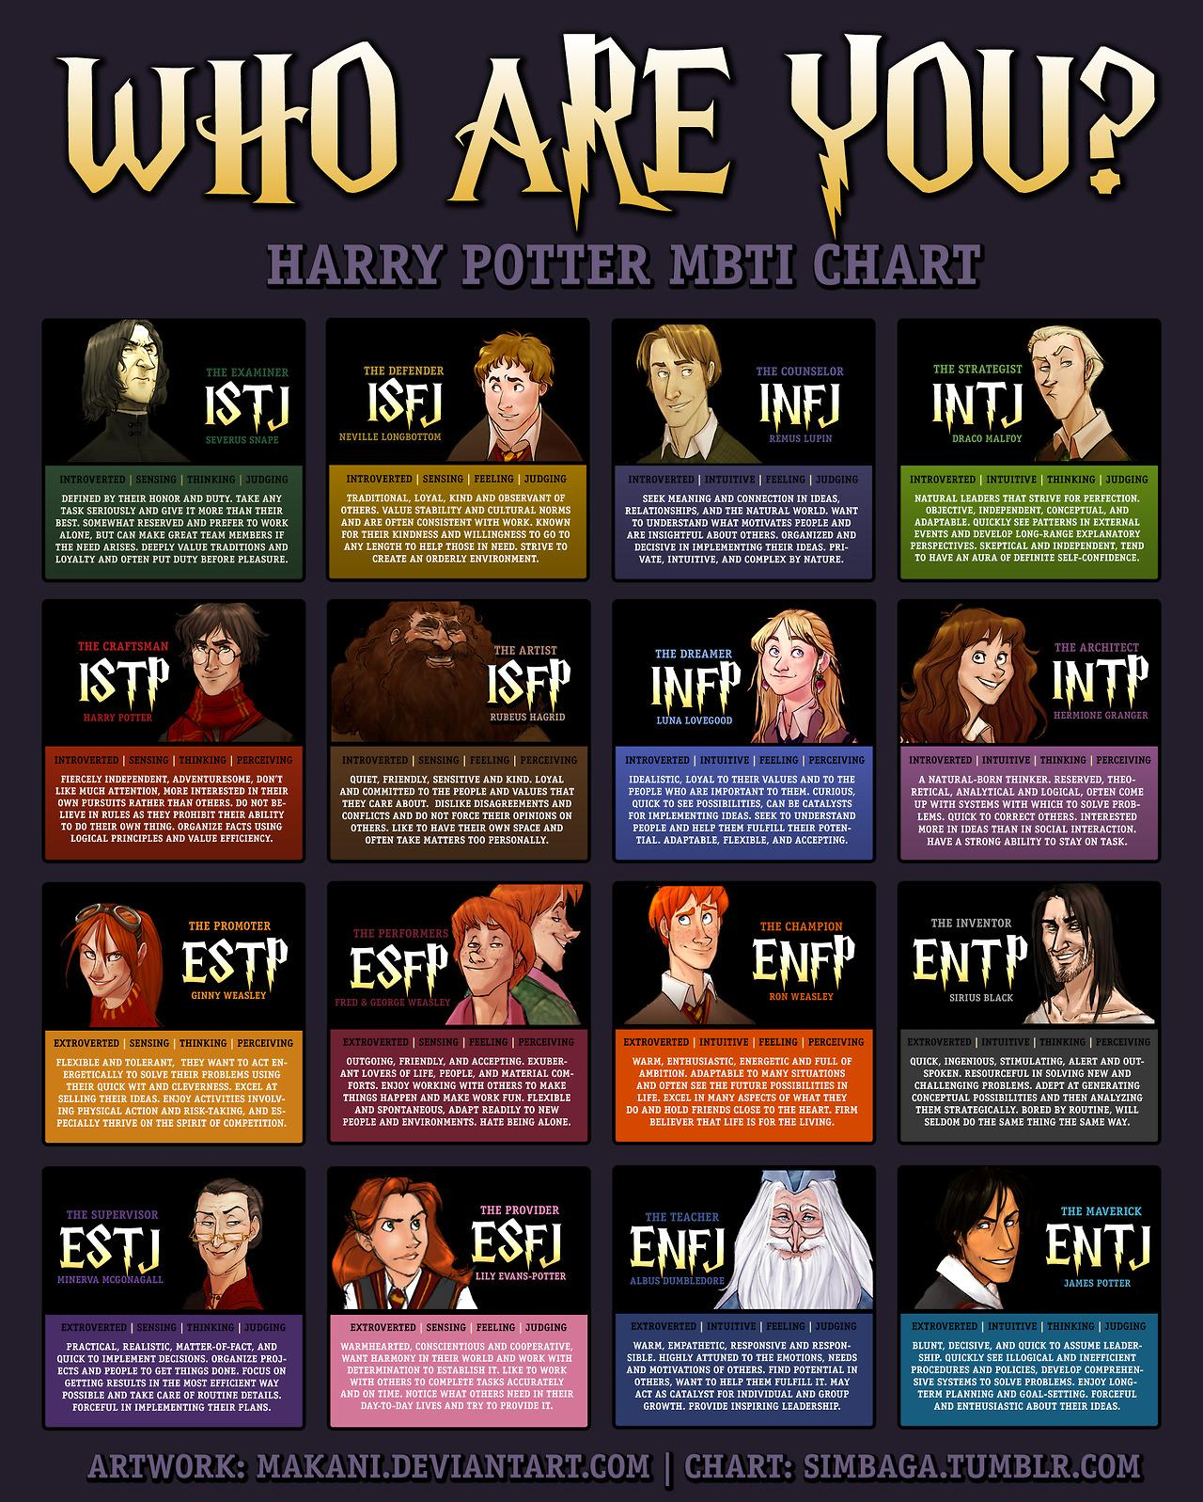

Slide 33
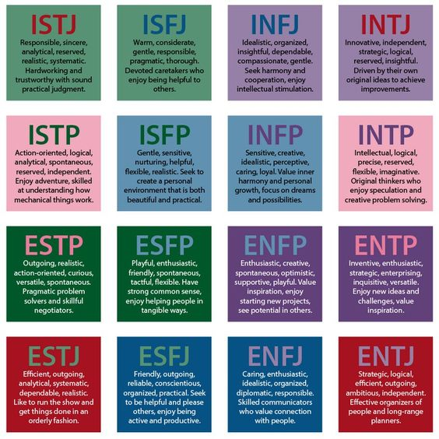

Slide 34
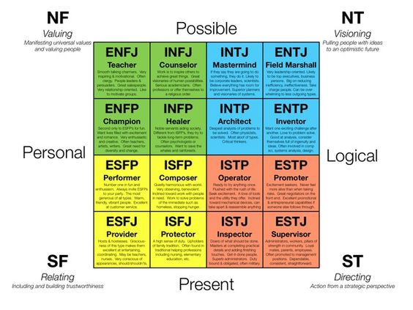

Slide 35
The Shadow Self
The discipline comes in when we have to pay attention to what we don't like, aren't interested in, don't understand, mistrust...when we have to read the poetry of our enemies-within or without. M. C. Richards

Slide 36
The goal of understanding one's personality (and maybe of spiritual growth as well) is to move from being tormented by one's stuff, to being amused by it.
If we can get it to the point where it is less serious, less personal, less scary, then we can begin to integrate it more fully as the powerful but neutral life force that it truly is, neither all good nor all bad, neither devil nor god.
T. Krieshok

Slide 37
MBTI-Related Websites
http://www.personalitytype.com
This is the homepage of the "Do What You Are" people, Paul Tieger and Barbara Barron- Tieger. It is intended for both the lay public and professionals and has a listing of additional resources - books, articles, websites, and workshops.
http://www.capt.org
Center for Applications of Psychological Type "A non-profit organization concerned with the constructive use of differences." This is the organization that provides the norms for the MBTIｮ, thus it's kind of a clearinghouse for scoring and training. The site itself is fairly commercial, but it is still of some interest. CAPT was founded by Dr. Mary McCaulley and Isabel Briggs Myers (who died in 1980) in 1975.

Slide 38
MBTI-Related Websites
http://www.aptcentral.org
Association for Psychological Type - also a commercial site (you can pay and become a member), but it does have some good information.
http://typelogic.com
This is a fun site. It does a nice job of analyzing the 16 types and even provides examples of well-known people of each type.

Slide 39
MBTI-Related Websites
http://www.cpp-db.com
Consulting Psychologists Press, Inc. - Publishers of the MBTIｮ
This is the only site where you can order the actual MBTIｮ (not a knockoff). It also has a host of other assessments, as well as many books and software packages about the various instruments.
http://keirsey.com
The Myers Briggs Type Indicator (MBTI)ｮ is not online (due to copyright reasons), but the most common knockoffs include the Keirsey Temperament Sorter and the Keirsey Character Sorter. Both questionnaires are online and even use the same language as the MBTIｮ (i.e. ENFP, ISFJ). The site is actually really informative and has some great jumping off points.

Slide 40
Discussion

